Slide 1


ايذاء الاخرين لفظيآ
Cyberbullying Detection
By:
John Hani
Mohamed Nashaat
Mostafa Ahmed
Zeyad Emad (Team Leader)
Under supervision of :
Dr. Eslam Amer, Dr.Ammar
Eng. Menna Gamil
Date:4\2\2019

Slide 2


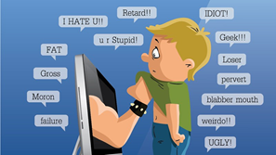
Introduction
Use superior strength or influence to intimidate someone
Cyberbullying has been manifesting our youth for quite some time, due to them being involved in one form of social media communication or another.
Our Scope
Social Media platforms will benefit from our software as cyberbullying rates will drop
Real life
The Internet

Slide 3
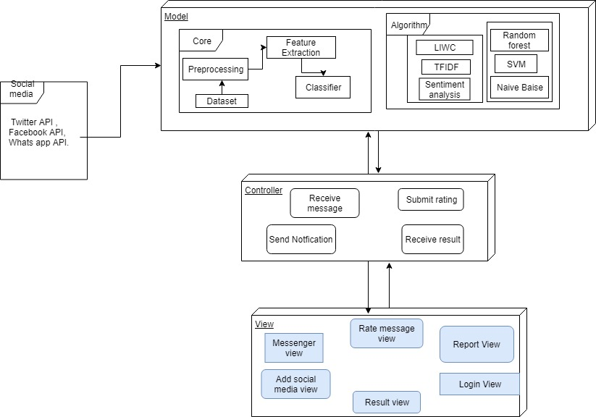
System Architecture
Feature
Extraction
Classifiers

Slide 4
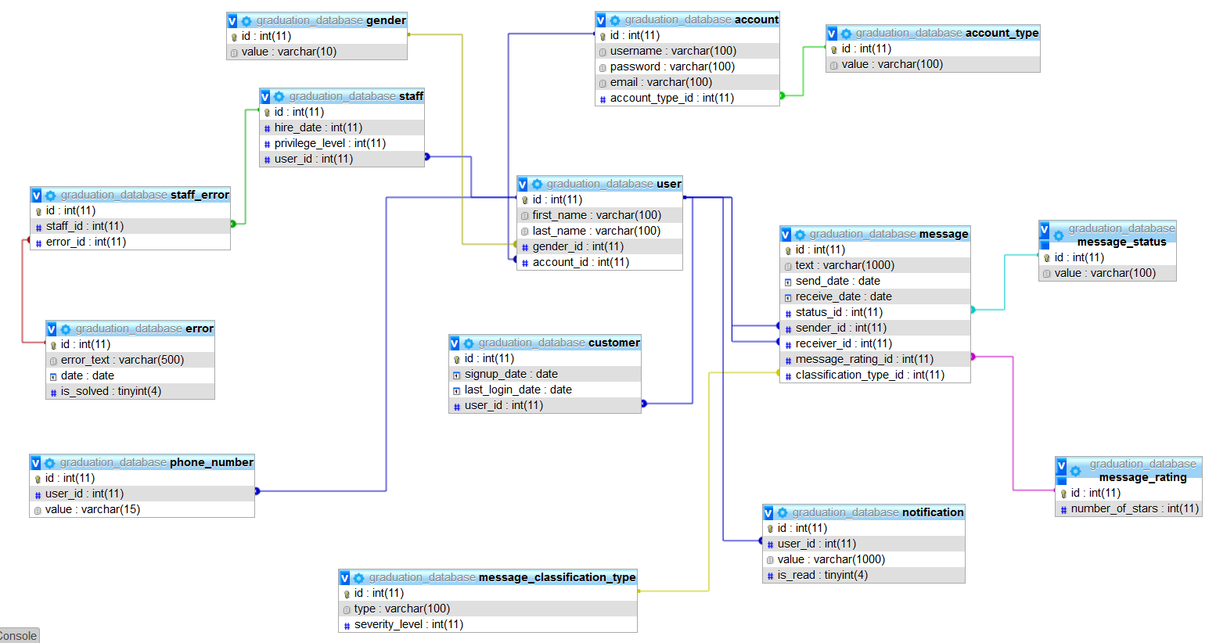
Database

Slide 5
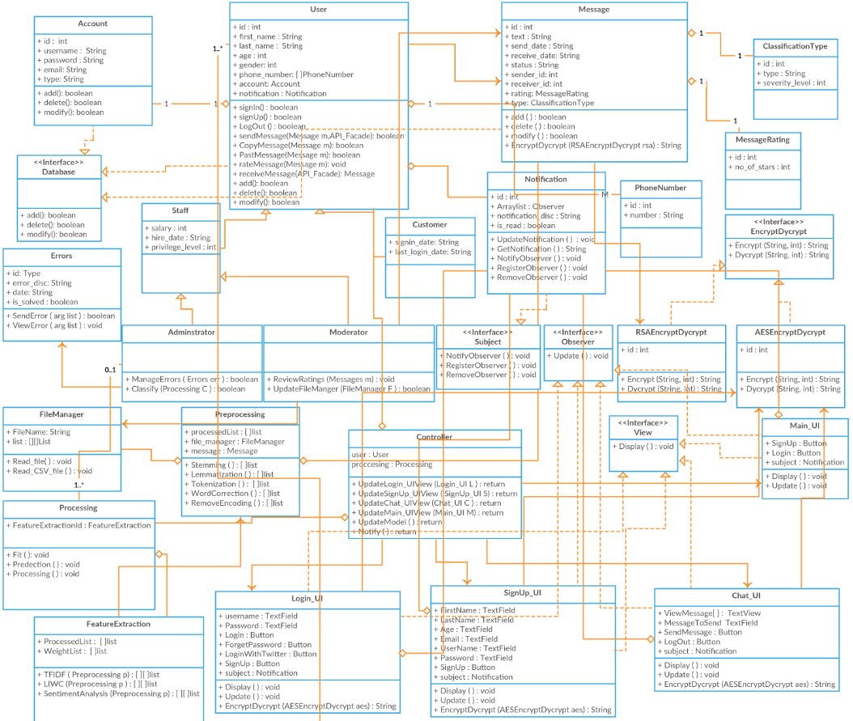
MVC Design Pattern

Slide 6
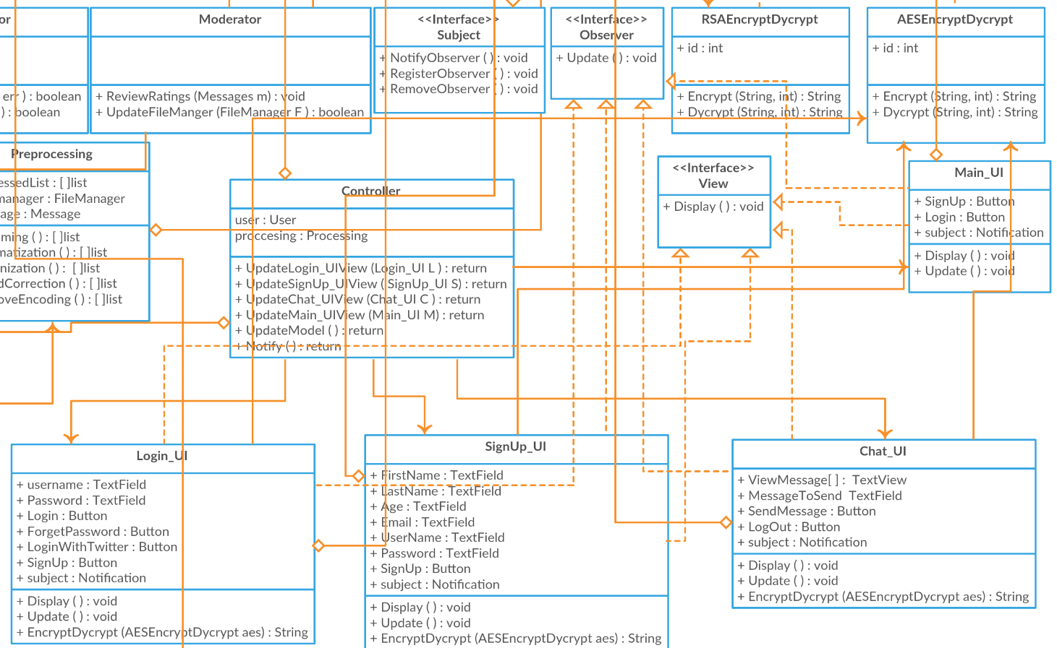
Observer Design Pattern

Slide 7
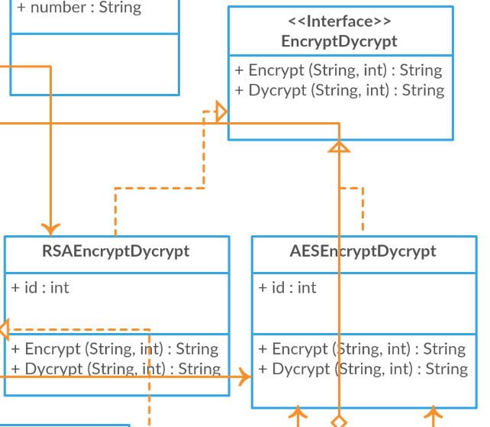
Strategy Design Pattern

Slide 8
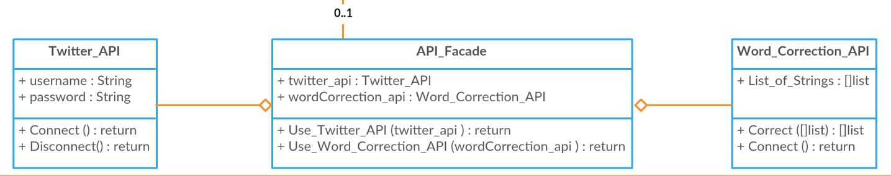
Facade Design Pattern

Slide 9
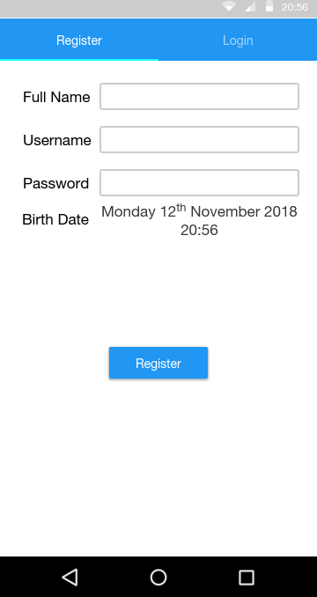
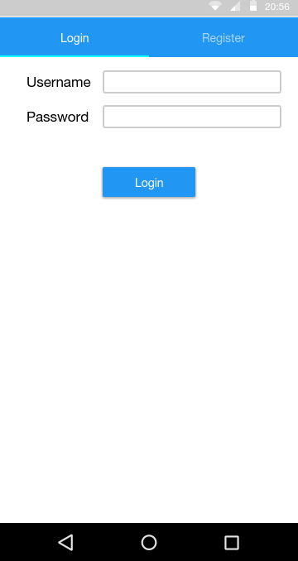
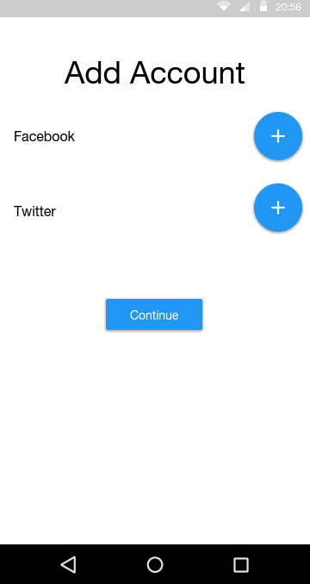
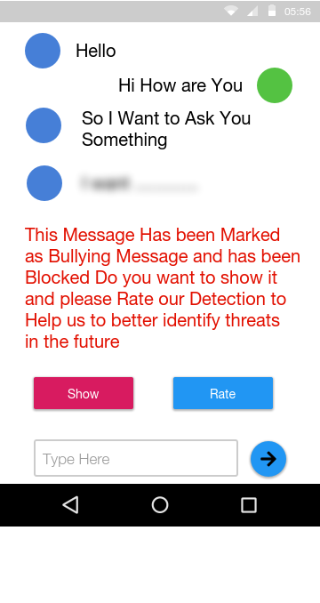
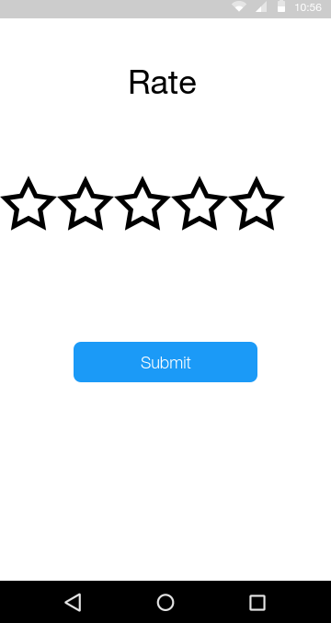
GUI

Slide 10
Design Rationale
Bag of words
Bag of word models don’t respect semantics of the word.
Logistic regression
is a statistical technique allowing researchers to create predictive models. t gives you a discrete binary outcome between 0 and 1. To say it in simpler words, it’s outcome is either one thing or another.
Skip gram
Failed to identify the combined word phrases.
Naïve Bayes
Naïve Bayes will have low recall and precision with small daataset.

Slide 11
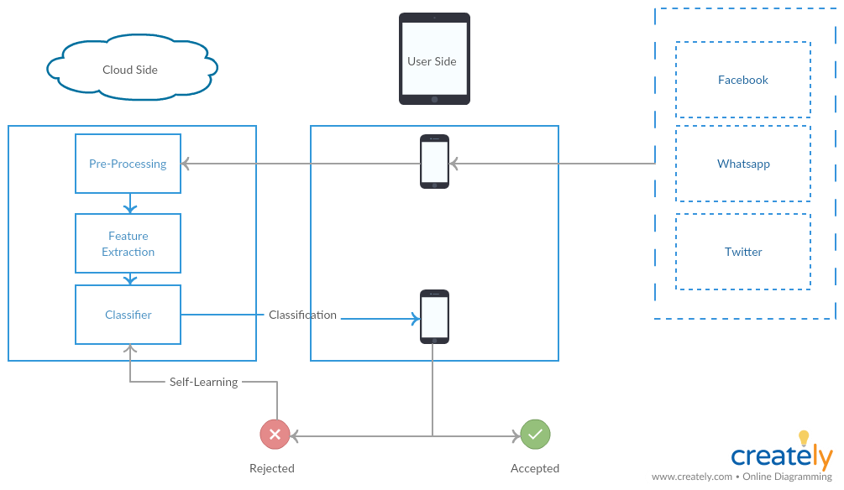



System Overview

Slide 12
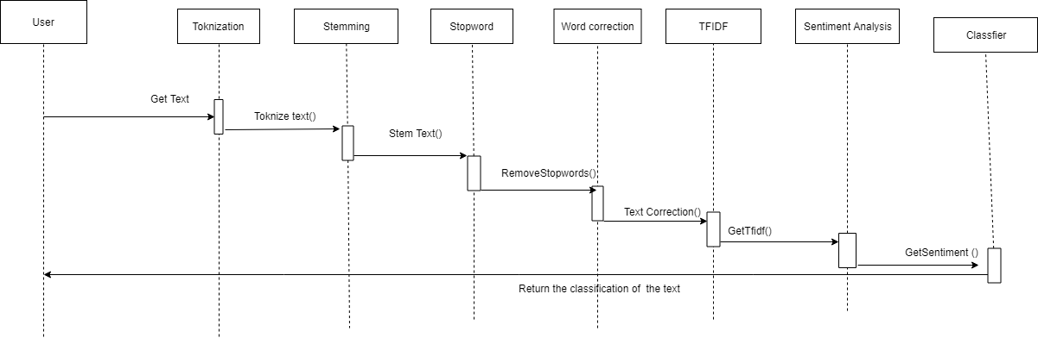

Slide 13
Demo

Slide 14
Any Questions ?

Slide 15
Appendix

Slide 16
Most Important Algorithm
Sentiment Analysis
What is Sentiment Analysis ?
Why we chose it ?
How it works ?

Slide 17
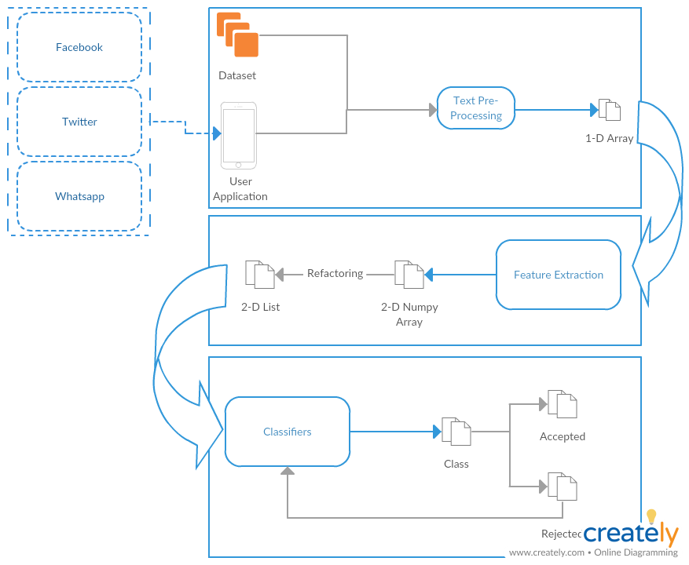
Business Model
Self Learning

Slide 18
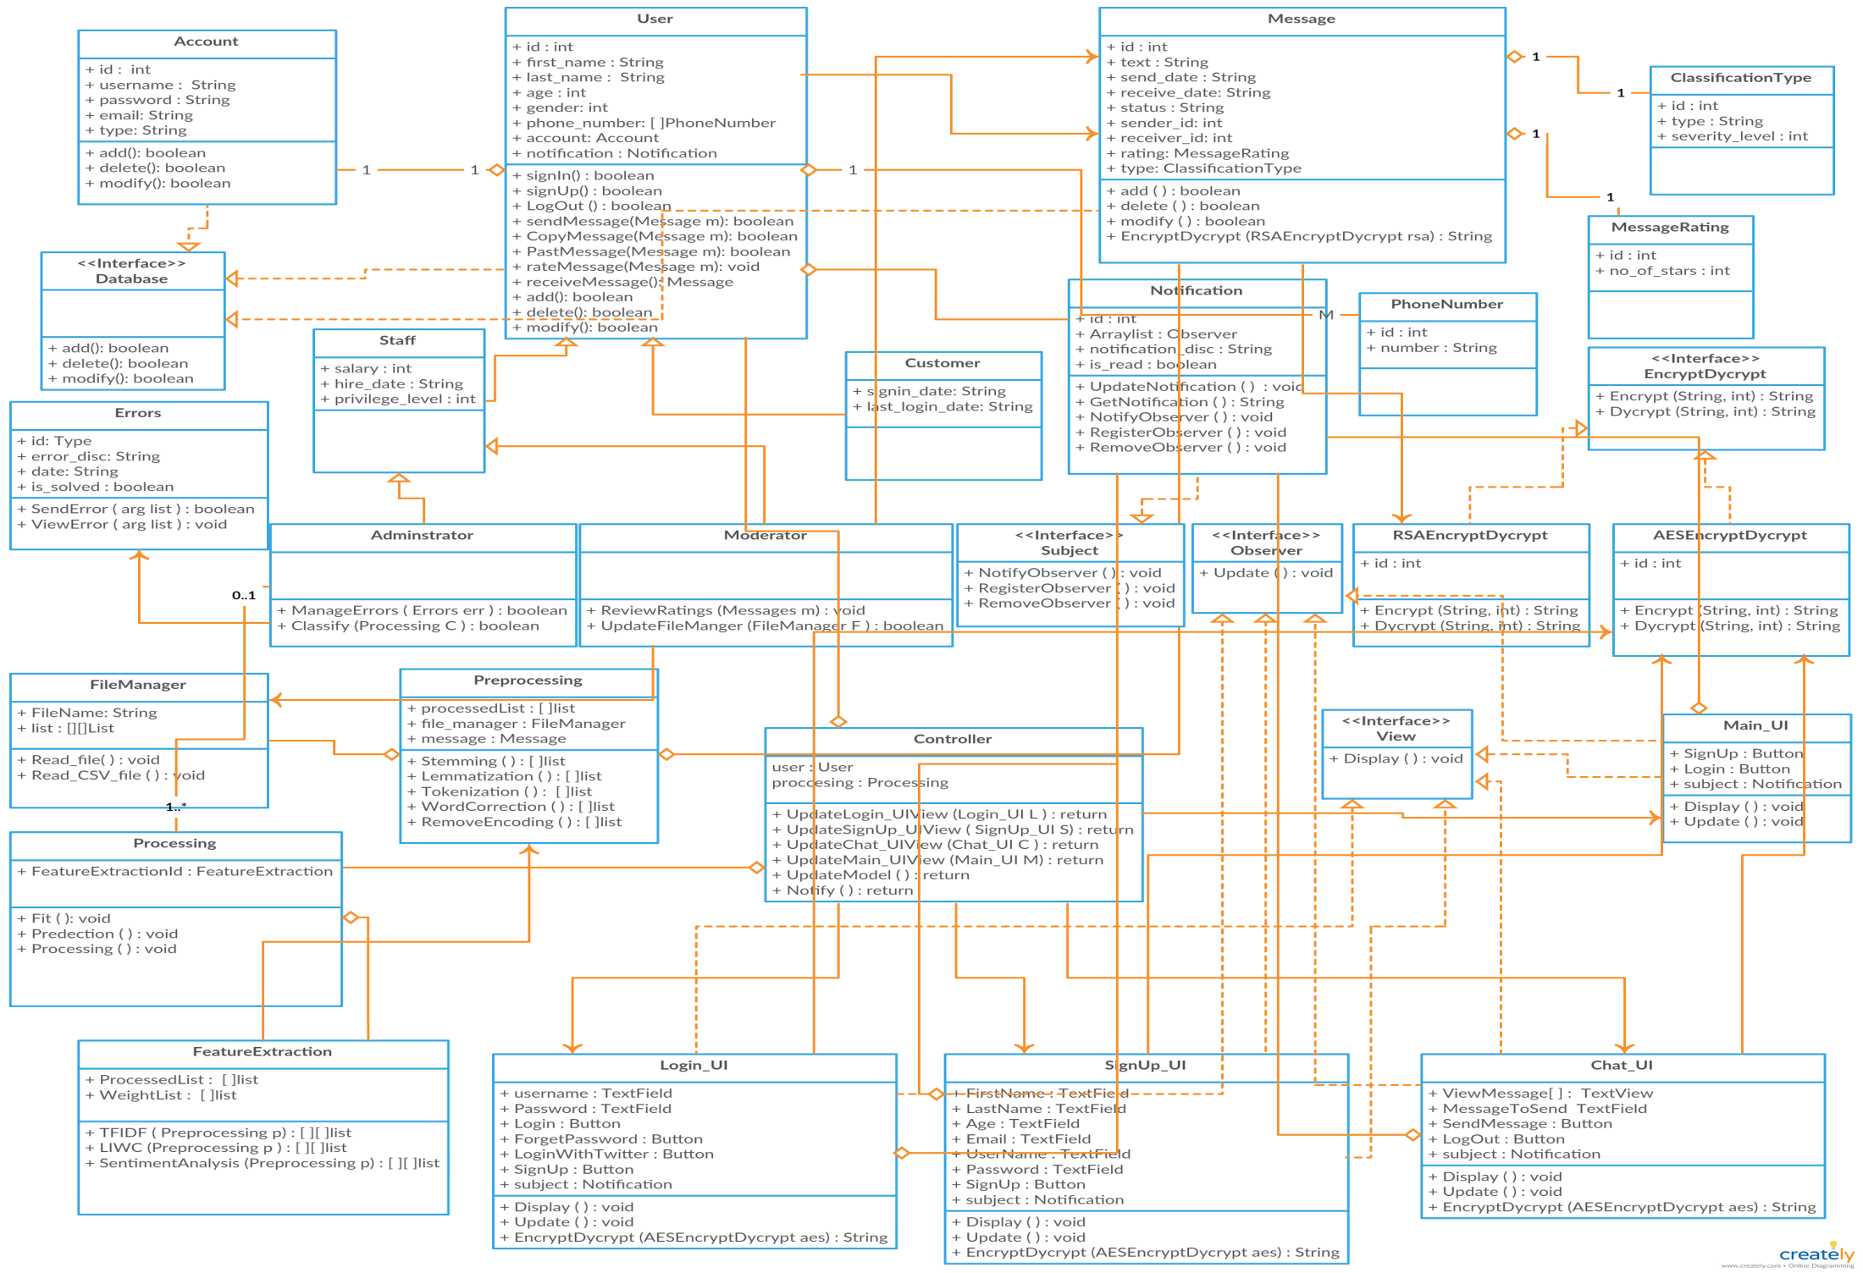
Class Diagram

Slide 19



Non Functional Requirements
Security
Maintainability
Portability
Have Encryption and Decryption
Self Learning
Both Desktop and Android

Slide 20
Market motivation

Slide 21
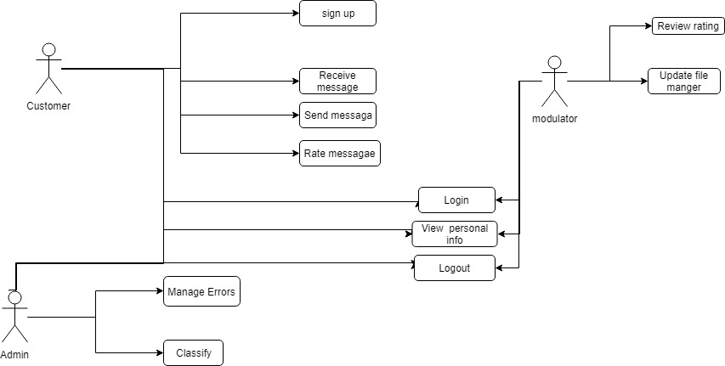
USE Case

Slide 22
Functional Requirement
User | Login with social media Rating
Messages | Send messages & Receive messages Encrypt & Decrypt
Processing | Preprocessing Feature extraction Classification
System | Notify Result Upgrade Classifier

Slide 23
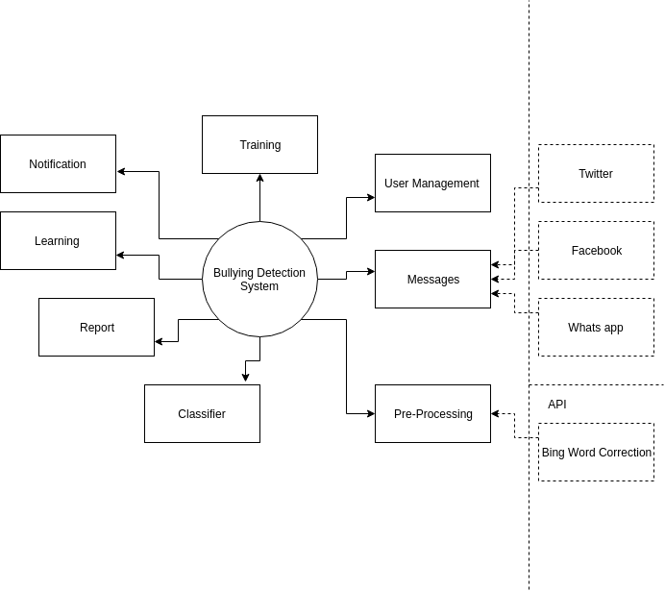
Context Diagram

Slide 24
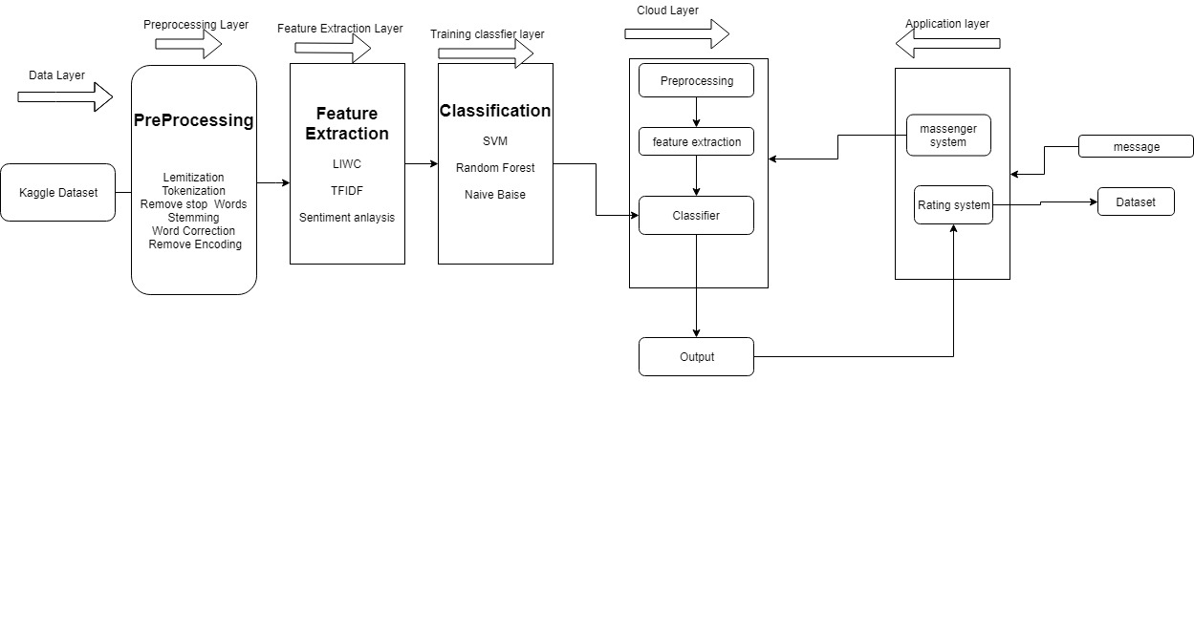
Block diagram

Slide 25
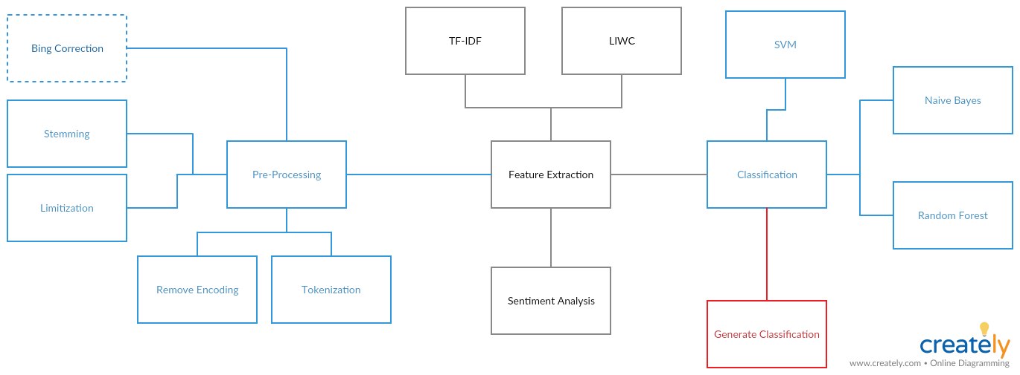
Block diagram

